Slide 1

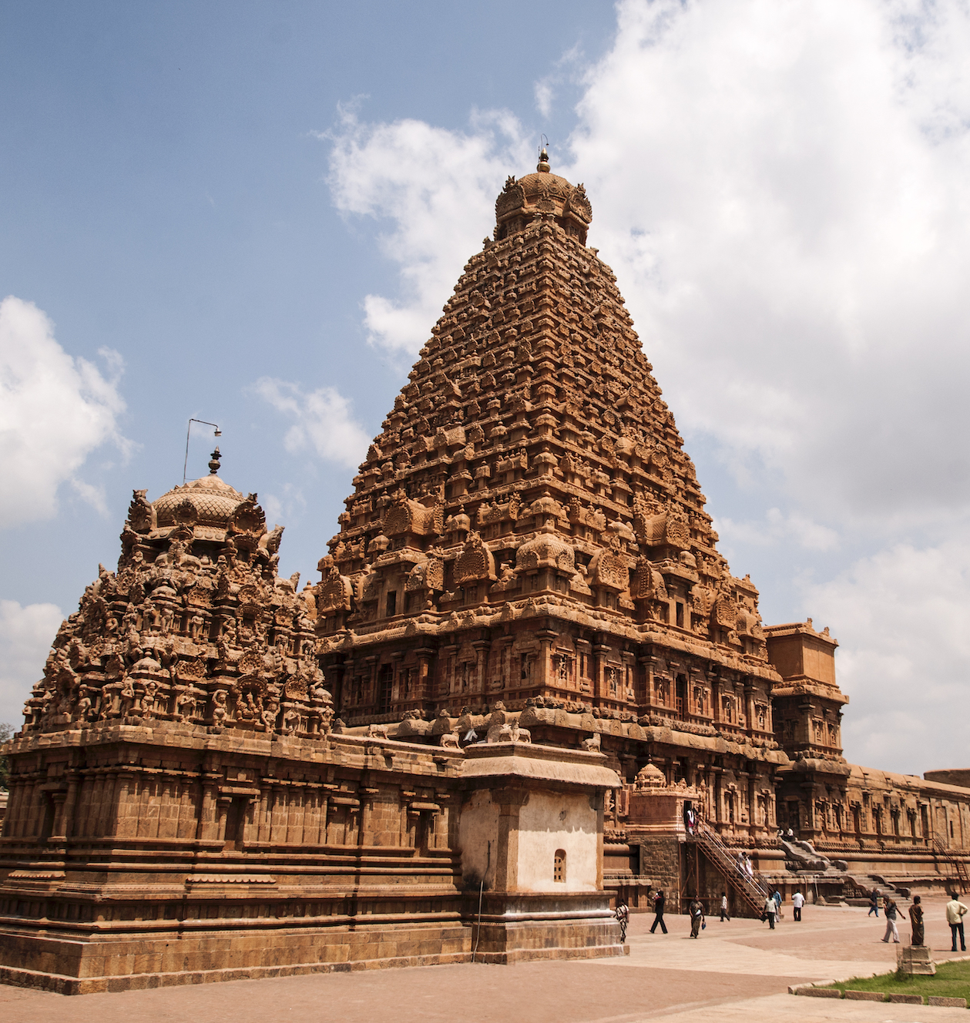

New Kings and Kingdom

Slide 2
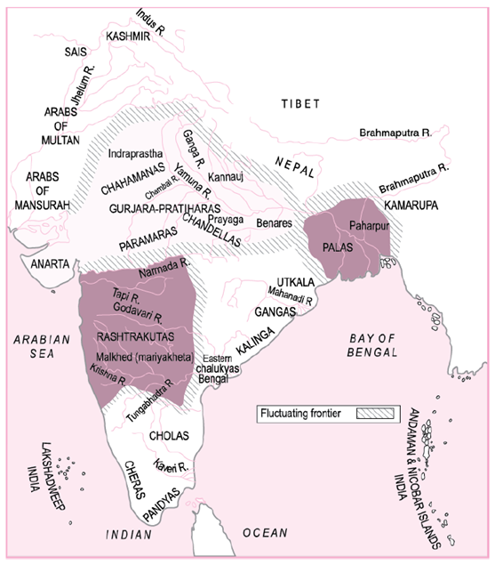
Submitted by :-
Priyanka Mukherjee
(B.ed2nd year )
Roll No. :- 230894010061
Topic – New Kings and Kingdom

Slide 3
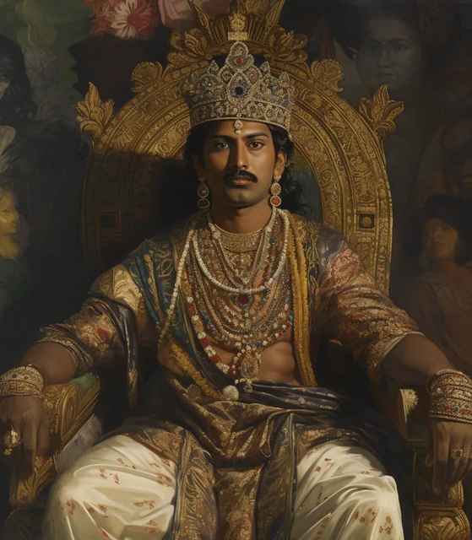
Learning Objectives
Students will examine the strategies employed by new dynasties to establish and expand their kingdoms during the period between the seventh and twelfth centuries in India.
Students will investigate the role of military prowess and political alliances in the rise of new dynasties, such as the Gurjara-Pratiharas, Rashtrakutas, Palas, Cholas, and Chahamanas (Chauhans), during the medieval period in India.
Students will evaluate the economic policies implemented by new dynasties to maintain their kingdoms, including taxation systems and resource management, based on historical records and inscriptions.
Students will analyze the significance of titles and honorifics adopted by new kings, such as maharaja-adhiraja and tribhuvana-chakravartin, and their implications for the consolidation of power and legitimacy in medieval Indian society.
Students will compare and contrast the administrative structures and methods of governance employed by new dynasties with those of earlier ruling entities in India, highlighting changes and continuities over time.

Slide 4
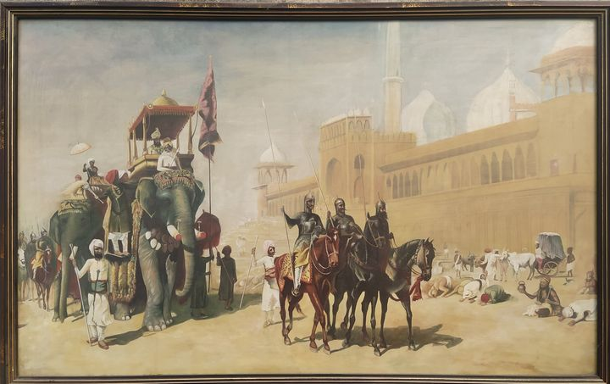
Engage
The pupil-teacher will divide the class into two groups and ask some questions.
Have you ever learned about any kingdoms or rulers from ancient Indian history in your previous studies?
Can you identify any famous kings or queens from Indian folklore or stories?
What comes to mind when you think about the term "dynasty" in the context of ancient civilizations?

Slide 5
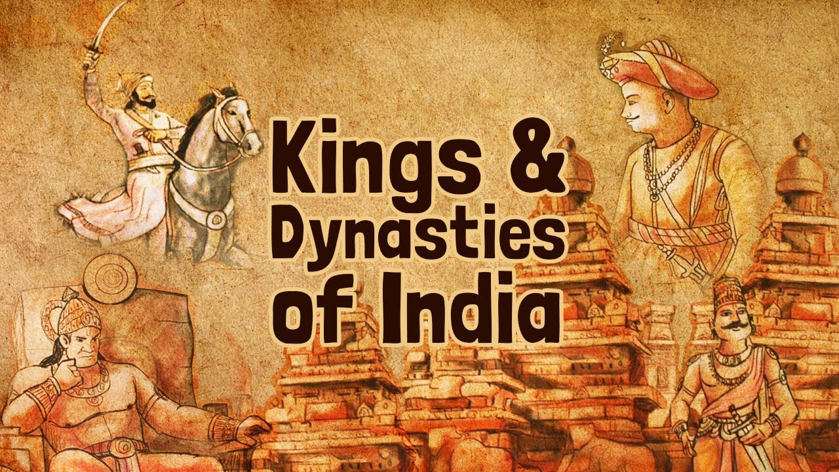
Explore
Students will be able to discuss in their groups
Can you name any ancient Indian dynasties that you have heard of before?
How do you think the emergence of new kings and kingdoms might have impacted the daily lives of people living in ancient India?
What were some common strategies employed by emerging dynasties to establish their kingdoms during the medieval period in India?

Slide 6
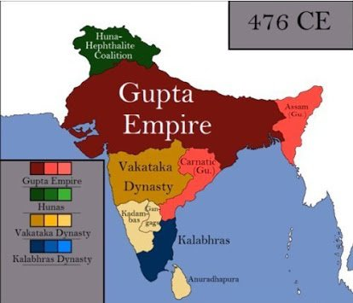
Explain
During the period from the 7th to the 12th centuries, significant historical developments took place in India, particularly in relation to the emergence of new kings and kingdoms. Here's an overview of some key events and changes during this time.
Emergence of New Dynasties: After the seventh century, new dynasties emerged in various regions of the Indian subcontinent. These dynasties replaced existing kings and rulers, often through military conquest or assertion of independence.
Strategies for Establishment: Powerful landlords and warrior chiefs played crucial roles in the establishment of new kingdoms. Some individuals from enterprising families used military skills to carve out their own territories.

Slide 7
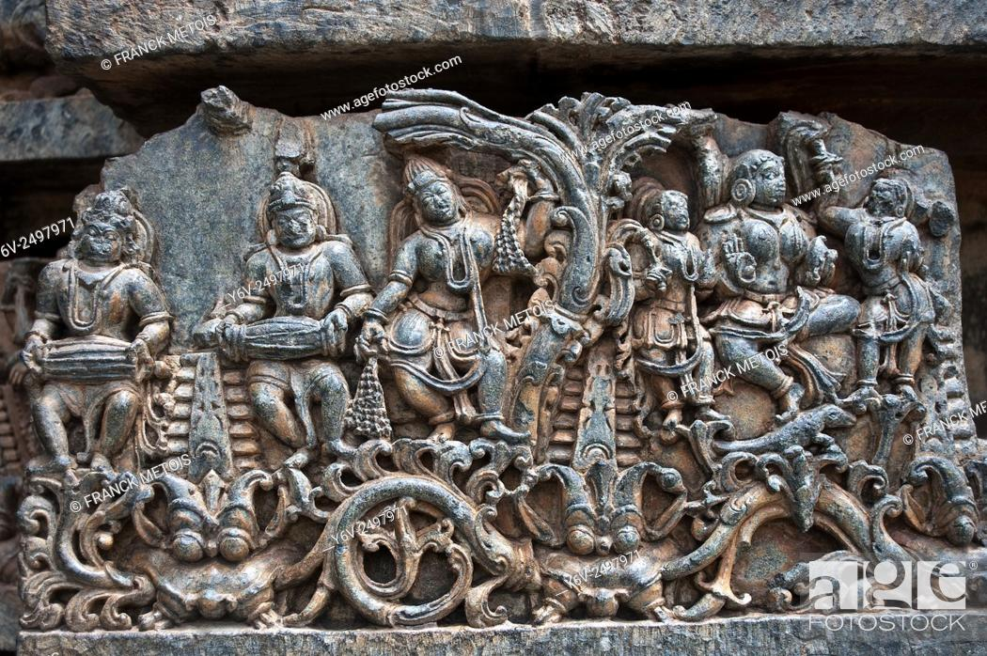
Title and Authority: New kings adopted grand titles like maharaja-adhiraja and tribhuvana-chakravartin to assert authority. Despite such titles, power was often shared with subordinates and associations of peasants, traders, and Brahmanas.
Administration and Revenue: Resources were obtained from producers like peasants and artisans through taxation and tribute. Revenue collected from traders and various forms of taxes, including vetti and kadamai, financed the king's establishment and construction of temples and forts.
Temples and Warfare: Temples often became targets during conflicts between rival kingdoms due to their wealth. New kings demonstrated power and resources by constructing large temples.
Impact on Society: The rise of new kingdoms reshaped the socio-political landscape of ancient India. Dynastic rivalries and warfare influenced societal structures and economic activities.

Slide 8
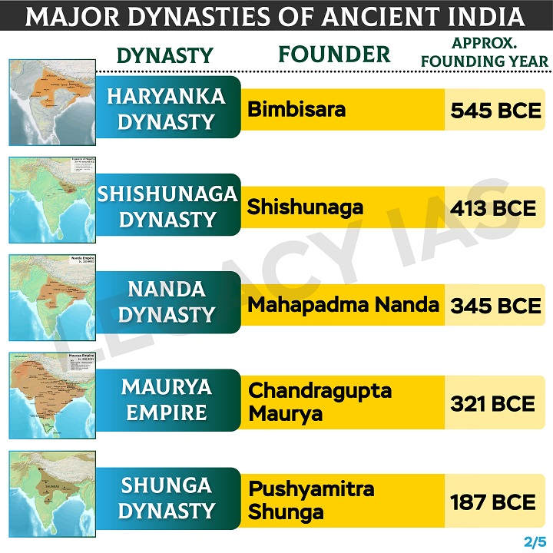
Evaluate
Now, the pupil-teacher asks the following questions to students
What were the main reasons behind the emergence of new dynasties during the medieval period in India?
Can you name any of the major ruling dynasties that arose between the 7th and 12th centuries, and where were they located?
How did powerful landlords and warrior chiefs contribute to the establishment of new kingdoms in ancient India?
What were some common titles adopted by new kings to assert their authority, and what do these titles signify?

Slide 9
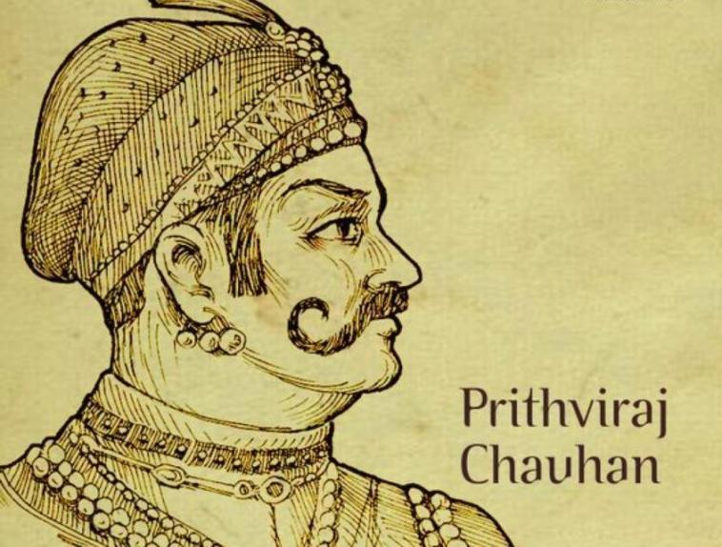
Elaborate
To evaluate the effectiveness of learning, the pupil-teacher will ask the following questions.
Who were the parties involved in the “tripartite struggle”?
What were the qualifications necessary to become a member of a committee of the sabha in the Chola empire?
What were the two major cities under the control of the Chahamanas?
How did the Rashtrakutas become powerful?
What did the new dynasties do to gain acceptance?

Slide 10
Thank You !

